Slide 1
Cauchy –Gelfand problem for quasilinear conservation law

Slide 2
G.M.Henkin, A.A.Shananin
Cauchy-Gelfand problem for quasilinear conservation
law, Bull. Sci. math., 138, (2014), p. 783-804.
http: //dx.doi.org/10.1016/j.bulsci.2014.01.001

Slide 3
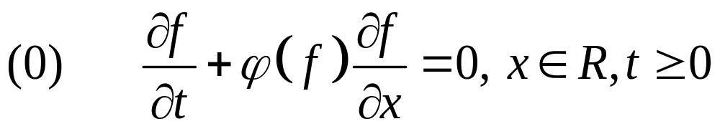
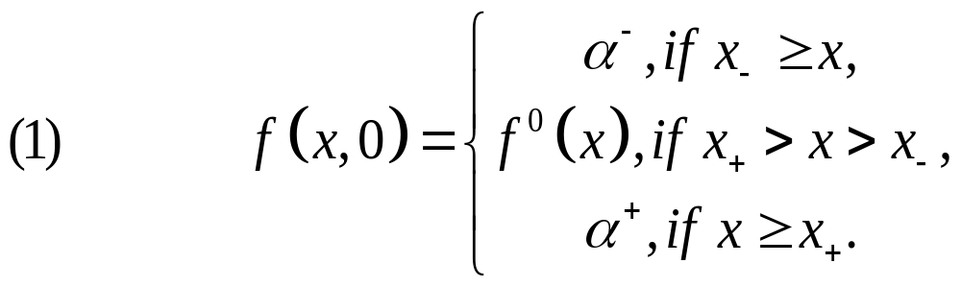
Cauchy problem for conservation law

Slide 4
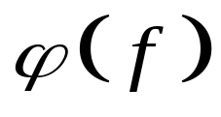
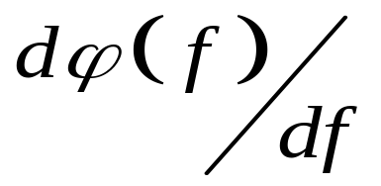
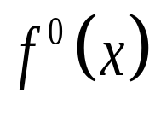
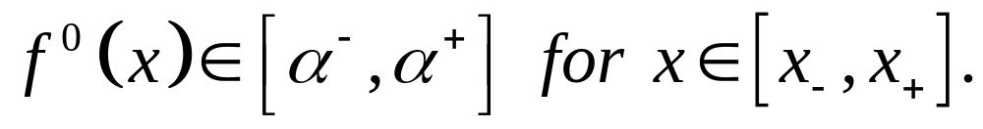
Assumption 1
Let be a positive, continuous
differentiable function of real variable f
such that has only isolated zeros.
Let be real-valued function of bounded
variation and

Slide 5
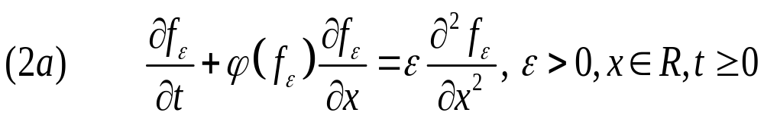
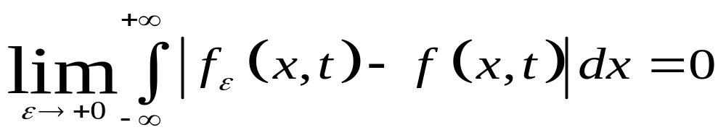
Method of vanishing viscosity

Slide 6
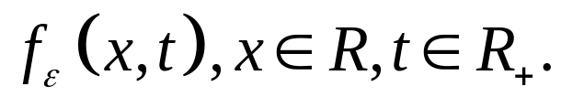

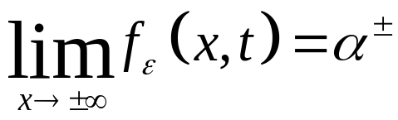
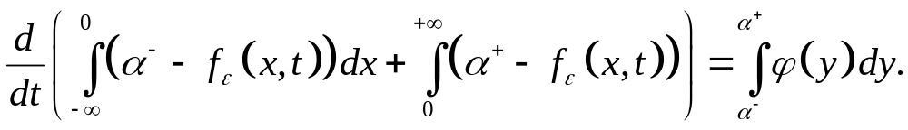
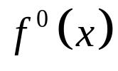

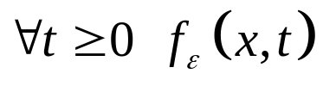

Theorem (I.M.Gelfand 1959, O.A.Oleinik 1959)
Under Assumption 1 Cauchy problem (1),(2a)
has a unique (weak) solution
This solution satisfies the following conservation
laws for and
Moreover, if the initial data is non-
decreasing in then for is non-
decreasing in

Slide 7
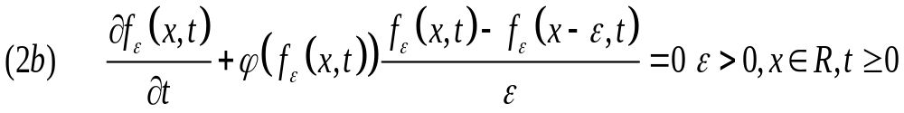
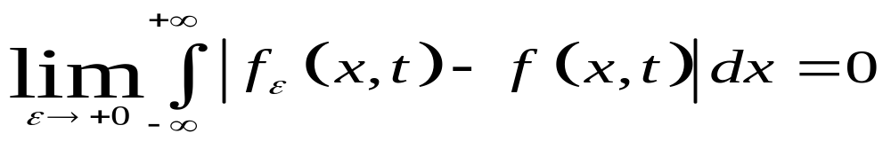
A difference-differential analogue

Slide 8
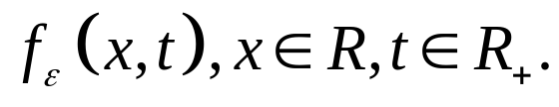

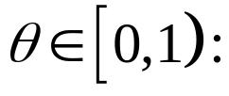
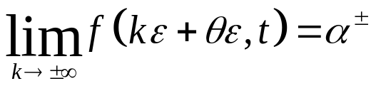
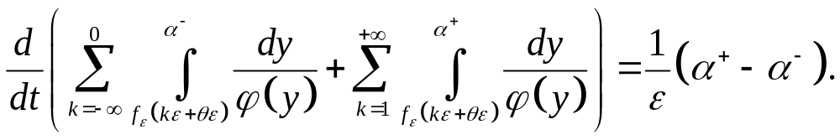
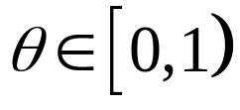
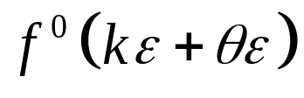

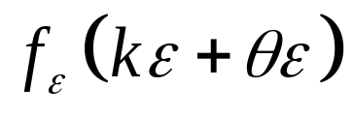

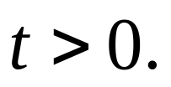
Theorem (G.M.Henkin, V.M. Polterovich 1991)
Under Assumption 1 Cauchy problem (1),(2b)
has a unique (weak) solution
This solution satisfies the following conservation
laws for and
Moreover, if for some the initial data
is non-decreasing in then
is non-decreasing in with the same for

Slide 9
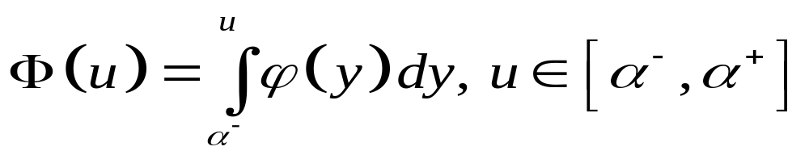
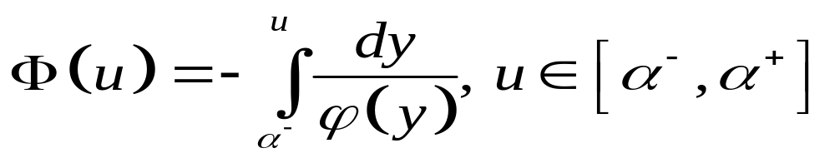
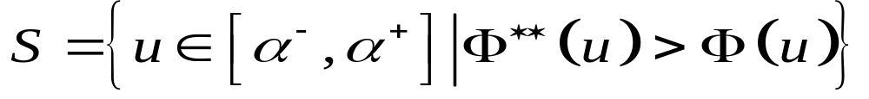
A system of waves
For (2a)
For (2b)

Slide 10
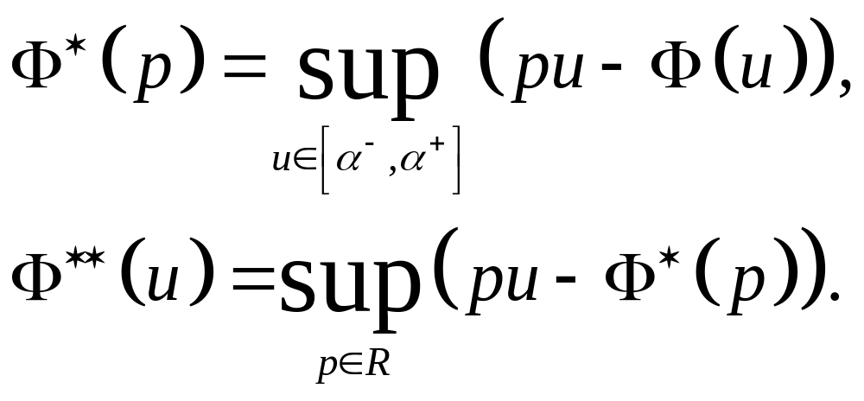
Legendre transform
Let

Slide 11
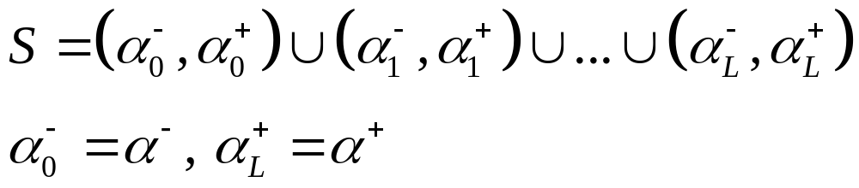
Assumption 2

Slide 12
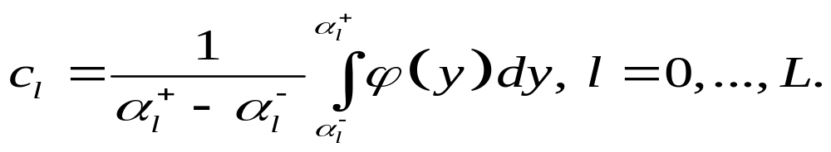
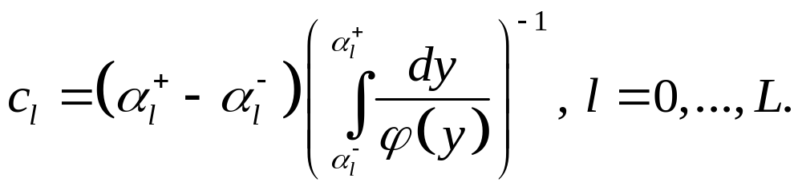
Velocities of traveling waves
For (2a)
For (2b)

Slide 13
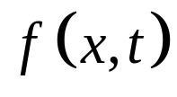

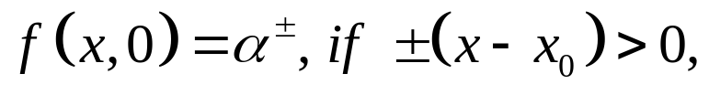
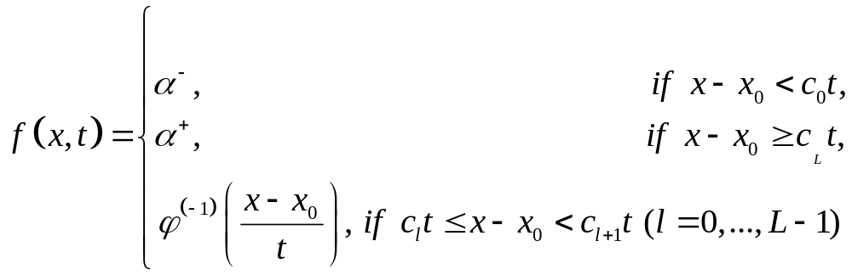
Theorem (I.M.Gelfand 1959)
Under Assumptions 1,2 be solution to (0)
with with initial condition:
has the following
piecewise smooth form

Slide 14
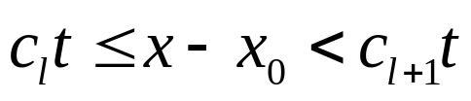
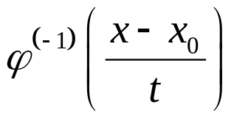


Theorem (I.M.Gelfand)
where increasing on the intervals
function determines rarefaction
waves on these intervals and positive jumps
of values for at the points
correspond to the shock waves concentrated at these points.

Slide 15
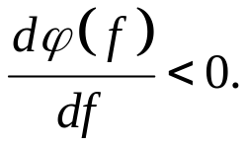


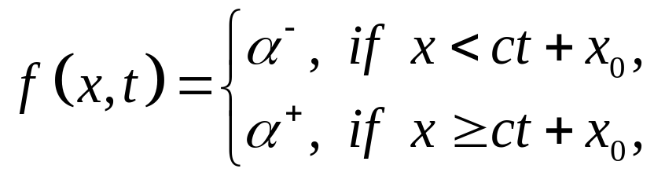

Theorem (A.M.Iljin, O.A.Oleinik)
Let under Assumptions 1 be solution to
(1),(2a), and Then such that
for
where shift parameter determined by
Maxwell formula:

Slide 16
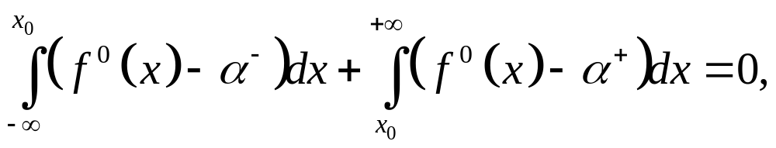

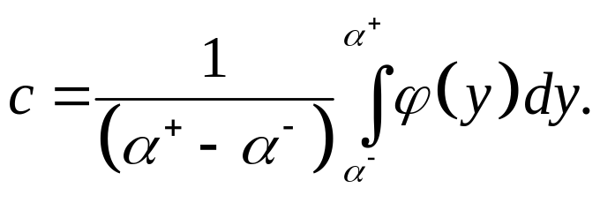
Theorem (A.M.Iljin, O.A.Oleinik 1960)
and is determined by Rankine-Hugoniot
formula

Slide 17
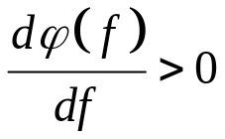
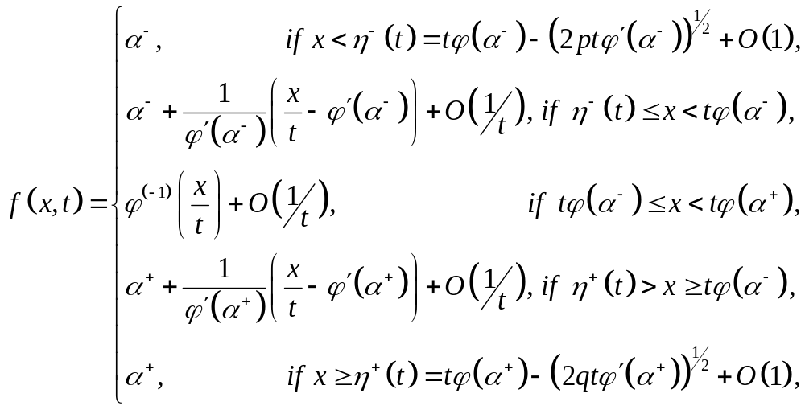
Theorem (C.Dafermos 1977)
Let under Assumptions 1 be solution to
(2a), and Then such that
for

Slide 18
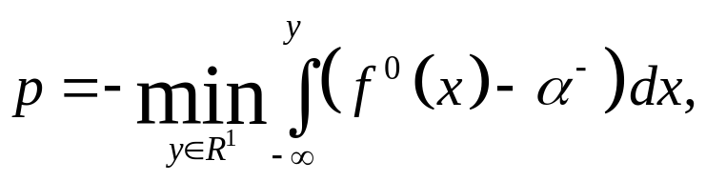
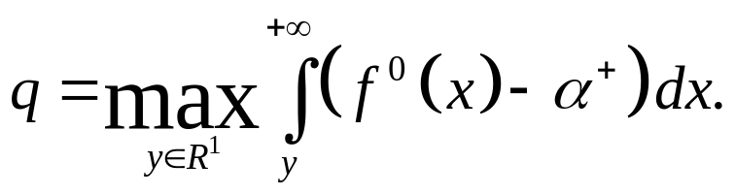
Theorem (C.Dafermos)
where

Slide 19

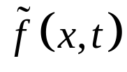

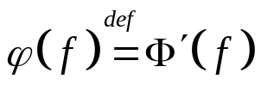
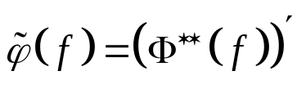
Theorem (S.N.Kruzhkov, N.S.Petrosjan 1987)
Let under Assumptions 1,2 be solution to
of the Cauchy problem (1),(2a), and with
non-decreasing initial data Let be
solution of the Cauchy problem (1), (2a) with
where the function is replaced by the
function and the initial function
is replaced by the function

Slide 20
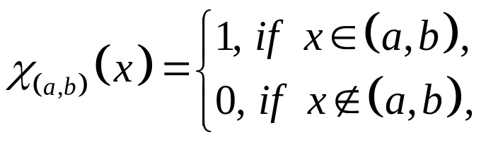
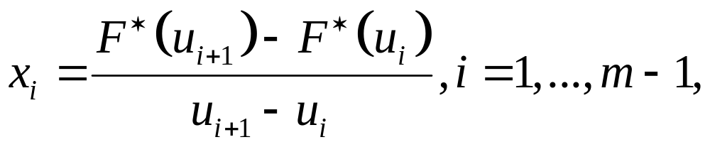
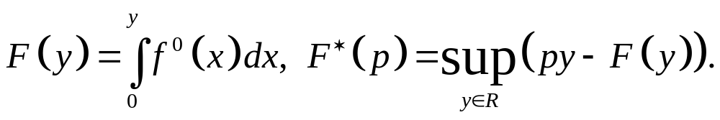
Theorem (S.N.Kruzhkov, N.S.Petrosjan)
where

Slide 21
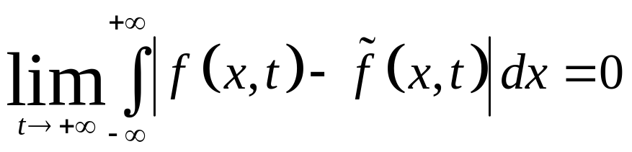



Theorem (S.N.Kruzhkov, N.S.Petrosjan)
Then
and the asymptotic locations
of shock waves for coincide with the
asymptotic locations of shock waves for
and so the shifts can be found explicitly

Slide 22


Assumption 3
Let the following inequalities be valid
Let be defined on the set

Slide 23







Localized Maxwell type conservation laws
Let
Let determine for (1), (2a) with
by Maxwell type formulas
and for (1), (2b) with by formulas

Slide 24





Main Theorem (2014)
There exists such , that for
The solutions to Cauchy-Gelfand problems (1),
(2a) (or (2b)) with have the following
asymptotic structure

Slide 25
References
1. I.M.Gelfand Some problems in the theory of quasilinear equations. Usp. Math. Nauk, 14,1959, p.87-158.Transl. Am. Math. Soc. 33,1963,p.295-381.
2. A.M. Iljin, O.A.Oleinik Asymptotic long-time behavior of the Cauchy problem. Math. Sb. 51, 1960, p.191-216 (in Russian).
3.C.M.Dafermos Characteristics in hyperbolic conservation laws, a study of structure and asymptotic behavior of solytions. In: Res. Notes Math., v.39, 1977, p.1-8.
4. S.N.Kruzhkov, N.S.Petrosjan Asymptotic behavior of solutions of Cauchy problem for non-linear first order equation. Russ. Math. Surv. 1987, v. 42, N5, p. 1-47.

Slide 26
References
5. G.M.Henkin, A.Shananin Asymptotic behavior of solutions of the Cauchy problem for Burgers type equations. Journal de Mathematiques Purées et Appliquees, 2004, v.83, N12, p.1457-1500.
6. G.M.Henkin, A.E.Tumanov, A.Shananin Estimates for solution of Burgers type equations and some applications. Journal de Mathematiques Pures et Appliquees, 2005, v.84, N1, p. 717-752.
7. G.Henkin. Asymptotic structure for solution of the Cauchy problems for Burgers type equations, J. Fixed Point Theory Appl., 1, (2007), 239-291.
8. G.M.Henkin, A.A.Shananin, Cauchy-Gelfand problem for quasilinear conservation law, Bull. Sci. math. 138, (2014), p. 783-804.

Slide 27
References
9. O.A.Oleinik Uniqueness and stability of generalized solutions of Cauchy problem for a quasi-linear equation. Usp. Mat. Nauk 14 (1959), p.167-170 (in Russian), Transl. Am. Math. Soc. 33 (1963), p. 285-290.
10. G.M.Henkin, V.M.Polterovich Shumpeterian dynamics as a nonlinear wave theory. J. Math. Econ. 20, (1991), p. 551-590.

